Slide 1
Transition Unlimited
Spring meeting
April 3, 10:00 a.m.
April 4, 2:00 p.m.

Slide 2
Transition Unlimited Action Plan
Plans were created for n= 362 schools, with 100% of teams participating ☺
As we near the end of the school year and work with our teams, think about what has been successful and what didn’t go as well as planned

Slide 3

Remember why our efforts matter
The Individuals with Disabilities Education Act (IDEA) and the Rehabilitation Act of 1973, as amended by Title IV of the Workforce Innovation and Opportunity Act (Rehabilitation Act), make clear that transition services require a coordinated set of activities within an outcome-oriented process that relies upon active student involvement, family engagement, and cooperative implementation of transition activities, as well as coordination and collaboration between the VR agency, the State educational agency (SEA), the LEA, and the school. In addition to the IDEA’s and the Rehabilitation Act’s requirements for the provision of coordinated transition services to students and youth with disabilities, the Rehabilitation Act also requires State VR agencies to collaborate with LEAs to provide, or arrange for the provision of, pre-employment transition services to students with disabilities.

Slide 4
Timeline for FY 24’
October
Transition Unlimited Action Plan Meetings held, plans built and created, Pre-ETS provided
November
Pre-ETS provided
December
Progress Monitoring e-mail sent, Pre-ETS provided
Jan.–Mar.
Pre-ETS provided
April
Progress monitoring reminder today, spring meeting, Pre-ETS provided from plans for students
May
Pre-ETS provided, finish school year
June
Pre-ETS provided
July
Pre-ETS provided
August
New school year, FY 2025 announcements, team registration, Pre-ETS provided, Virtual meeting
September
All progress monitoring submitted by 9/13, Pre-ETS provided

Slide 5
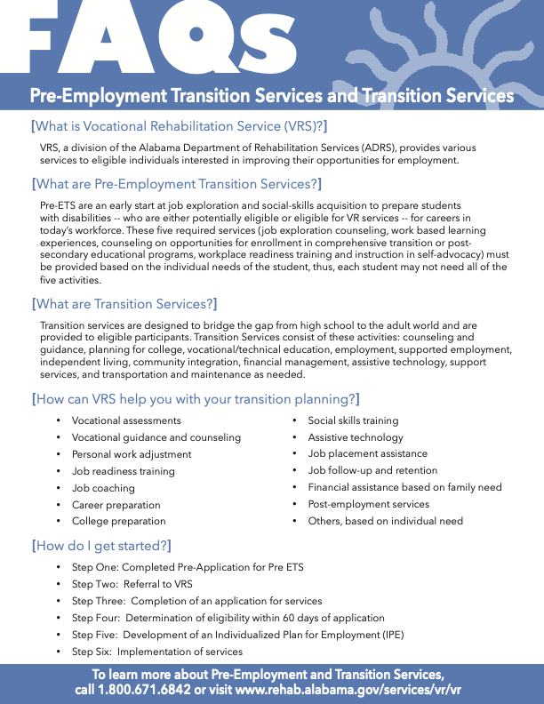
ADRS Pre-employment Transition Services

Slide 6


Slide 7

Will be held at Auburn University
June 1-6
In process of notifying delegates now!

Slide 8
JETS Summer 2024
Workshops: June 10 - 28 and July 8 - 26 (July 29-Aug 2 is make-up week)
United Ability: June 10 - July 26
Flourish: June 3 - June 28th
Easterseals of Birmingham: June 10 - August 2
Goodwill Gulf Coast: June 3 – July 19 for Mobile Co.; June 10 – July 26 Baldwin Co.
ICan Train:
May 27-July 19 Monroe and Escambia (Monroe and Escambia will decide in April on the 4 weeks they would like to start the program. One school system will start May 27-June 21. The second will start June 24 - July 19)

Slide 9
JETS Summer 2024
July 1 – July 26 Baldwin if they choose to participate.
Sherri Williams: May – August. 15 – 30 WBL days during the summer.
Opportunity Center: June 3 - 21 Oxford City Schools; July 8 - 26 Anniston City and Calhoun co.
EASE: Decatur; June 17 – July 19
Easterseals Central Alabama: June 3 – July 12 Lowndes Co; June 10 – July 19 Montgomery county; June 17 – July 26 Prattville and Elmore County
The Transition Team: June 10 – July 19 Huntsville and Madison
Phoenix Huntsville Rehab: Huntsville Location - 2 sessions; June 3 – June 28 and July 8 – 26
Phoenix Huntsville Rehab: Athen’s location – June 17 – July 26

Slide 10
JETS Summer 2024
Easterseals West Central Alabama: Marengo Co.,Linden and Demopolis school system; June 3 – July 26
UCP of West Alabama: June 3 – July 19 with a make up week of July 22 – 26
Achievement Center: 2 sessions - June 10 – July 3 and July 8 – July 31
UCP Mobile: June 24 – July 19
Phoenix Huntsville Rehab: Scottsboro, 2 sessions; June 3 – June 21 and July 8 – July 26
Easter Seals West Central Alabama: Chilton school systems (Chilton Co., Verbena, Thorsby, Jemison,
  Maplesville and Isabella) June 3 – July 26
Easterseals West Central Alabama: Dallas co. and Selma City; June 3 – July 26
Triumph Services: EBSCO Industries Publisher’s Warehouse, 2 sessions June 10 – 26 and July 8 – 26
The Arc of Jackson County: June 3 – June 21

Slide 11
JETS Summer 2024
Independent Advantage: June 10 – August 2
Easterseals of Northwest Ala: Decatur area; 2 sessions, June 10 – 28 and July 8 – 26
The Arc of Madison Co: June 17 – July 26
Easterseals West Alabama: 3 sessions June 10 – July 5, July 8 – August 2 for Tuscaloosa; June 17 – July 12 for outlying counties.
Easterseals Northwest Alabama: Muscle Shoals area; 2 sessions, June 10 – 28 and July 8 – 26
Easterseals Northwest Alabama: Jasper area; June 10 – July 26
Darden: Cherokee Co., June 3 – July 26.
Darden: Etowah Co., June 3 – July 26
Darden: Gadsden City, June 3 – July 26
Darden: St. Clair Co., June 3 – July 26

Slide 12
JETS Summer 2024
Triumph Services: Wood Fruitticher wholesale grocery, 1 session for 5 weeks June 10 - 28 then July 8 – 19
Central Alabama Reach Out Center (CAROC), for Talladega county and city schools, Sylacauga and Central HS for Clay and Coosa Counties; 2 sessions, June 3 – 27 and July 8 – 31
Wiregrass: June 3 – 21 for Geneva, Dale and Coffee counties
June 24 – July 15 for Houston County
July 15 – August 2 for Henry County and Dothan City
Arc of Clarke Co: June 3 – 21 for Clarke County and July 8 – 26 for Washington and Choctaw Counties
Rainbow 66 Storehouse: June 3 – 21
The Arc of Central Alabama: Jefferson Co., June 10 – July 19
The Arc of Central Alabama: Blount Co., June 10 – July 19

Slide 13
Jobs for Alabama Graduates
“JAG”
Some participants are dually served students
JAG curriculum includes workplace readiness training
We share a same vision and goal
Maximize opportunities for successful outcomes
Collaboration enhances service provision

Slide 14
Because there is great value in JAG..
ADRS/VR is excited for our shared students to participate in JAG
  Each JAG program has a designated amount of slots/students VR will sponsor
  Each JAG program has an assigned VR liaison counselor & VR supervisor to collaborate with JAG liaison/supervisor
  JAG liaison list is updated and provided annually to enhance collaboration for a streamlined process for identifying and reporting on specific students

Slide 15
How do we ensure all VR JAG Slots are filled each academic year?
Collaborate, Collaborate, Collaborate
JAG specialist and liaison VR counselor will discuss participants to ensure designated slots are filled by VR participants for academic year 2024-2025.
  JAG caseloads reviewed and if SWD are already in VR caseload in either pre app or higher, those students may fill the slot requirement (continue with steps 2-6)
  If no JAG participant in JAG caseload is a SWD in a VR caseload, VR liaison will refer a SWD to participate in JAG (once agreed upon and accepted, continue with steps 2-6)
An authorization in the amount of $1375 (prepopulated in SMILE) with P Code of P040214 should then be authorized for each participant for designated slots and provided to JAG specialist. The authorization will be made to the County School listed on this spreadsheet. You may also provide liaison with standard Workplace Readiness Pre ETS-Form (attached), in the event they no longer have the electronic or hard copy version.
SWD will participate in JAG classes. At the end of six weeks, JAG specialist will provide VR liaison a completed “Standard Pre ETS-Workplace Readiness Report” and an invoice for each consumer holding the slot(s). Report should have JAG 30+ hours selected.
This invoice should then be paid so funds can be released to designated school systems.
Although you will have continued collaboration with JAG specialist, only one authorization per designated VR slot (SWD), is allowable for “JAG” and you will only receive one standard Pre ETS report from JAG specialist per designated slot (SWD).
Prior to the end of the school year, VR liaison and JAG liaison will meet to discuss participants for the upcoming school year and the process will then start over the following school year.

Slide 16
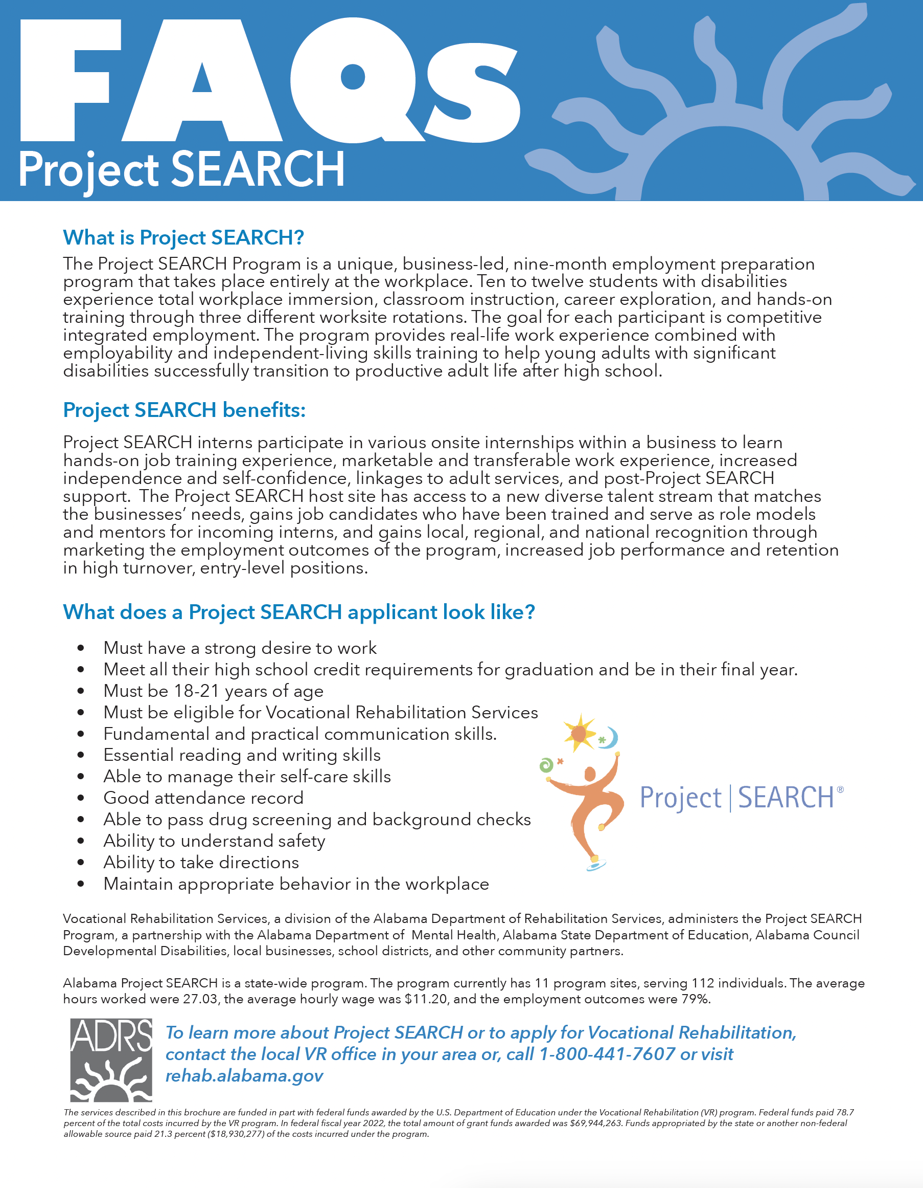
Project Search

Slide 17
Project Search
Program Area | Date & Time | Location | Additional Notes
Shelby County | May 9th ▪ 5:00 p.m. | Shelby County Instructional Service Center 601 1st Street South Alabaster, Alabama 35007
Hoover City | May 10th ▪ TBD | Renaissance Birmingham Ross Bridge Golf Resort and Spa 4000 Grand Avenue Birmingham, Alabama
Marshall County | May 10th ▪ 1:00 p.m. | Marshall Medical Professional Center North 11491 US Highway 431 Guntersville, Alabama
Anniston | May 13th ▪ 10:00 a.m. | Regional Medical Center - Auditorium 400 East Tenth Street Anniston, Alabama
Montgomery | May 13th ▪ 10:00 a.m. | Easterseals Central Alabama 2185 Normandie Drive Montgomery, Alabama
Huntsville | May 14th ▪ 10:30 a.m. | Huntsville Hospital – Corporate University 109 Governor’s Drive Huntsville, Alabama
Gadsden/Etowah County | May 15th ▪ 1:00 p.m. | Gadsden Regional Medical Center 500 Building Conference Room Gadsden, Alabama
Gadsden/St. Clair | May 17th ▪ 11:00 a.m. | Colonel Robert L. Howard State Veterans Home 7054 Veterans Parkway Pell City, Alabama
Birmingham/UAB | May 20th ▪ 1:00 p.m. | University of Alabama Birmingham Medicine Margaret Cameron Spain Auditorium 615 18th Street South Birmingham, Alabama
Mobile | May 21st ▪ 10:00 a.m. | The Battle House Renaissance Mobile Hotel & Spa 26 North Royal Street Mobile, Alabama 36602 | There are two programs, and the ceremony will be combined.
Mobile | May 21st ▪ 10:00 a.m. | The Battle House Renaissance Mobile Hotel & Spa 26 North Royal Street Mobile, Alabama 36602 | There are two programs, and the ceremony will be combined.
Program Area | Date & Time | Location | Additional Notes

Slide 18

Questions
Please ask any questions you have in the Zoom Q&A

Slide 19
Thank you for attending today’s webinar
We appreciate your continued dedication to serving youth with disabilities in Alabama

